Slide 1
Including people with learning disabilities and autism in research
Introduced by Anne Rathbone, Mikey Reynolds and Julia Roberts
Resilience Forum
9th June 2021

Slide 2
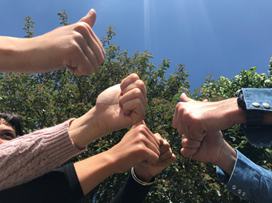
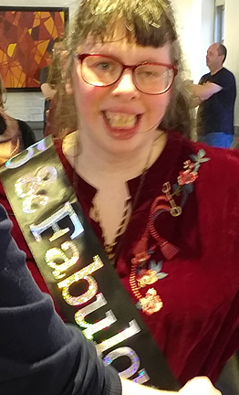
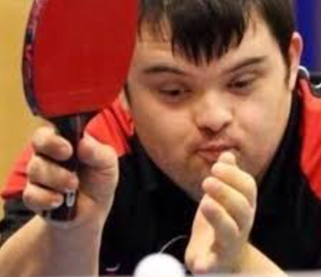
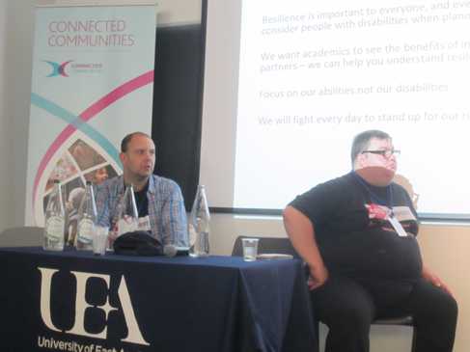
We are Arts Connect, part of Culture Shift
We are Ambassadors and Resilience Co-researchers

Slide 3
Our development community
Working on this project so far have been:
Arts Connect – Culture Shift.
Highfurlong school for pupils with Special Educational Needs and Disabilities, Blackpool.
Blackpool Resilience Revolution Co-researchers.
Academic researchers from University of Brighton (some who identify as having learning difficulties or autism and some who don’t).
Parents and carers of people with learning disabilities.
PhD students from University of Brighton Centre of Resilience for Social Justice
Last but not least Henry and Lisa who helped us make the film.

Slide 4
Our presentation today
Today we will show a film that our community has made together.
We will show the film in three parts and go over some of the key points after each part.
The 3 main parts of the presentation are:
Why it is important to include people with learning disabilities and autism in research.
What we know and believe about how to properly involve people with learning disabilities and autism in research.
How we think research funders and university-based researchers can help to make sure research is more inclusive of people with learning disabilities.
Then Eve from the Economic and Social Research Council will give a reply.
We will go into small groups to discuss our ideas and then come back to talk about what next steps we can all make.

Slide 5
Film presentation: Including people with learning disabilities in research
Clip 1: The ambassadors and co-researchers in Blackpool talking to Rosie
This file has been removed from the presentation to reduce the file size, but you can view the whole film on YouTube here: https://youtu.be/mDeKUl1z7Bg

Slide 6
Why should people with learning disabilities and autism be included when health or social science researchers design their projects?
Because their needs and views are just as important as others (for example, see work by Abell et al., 2007).
Their involvement can make research knowledge much better (for example, see work by Beighton et al, 2017).
Sometimes the particular needs of people with learning disabilities and autism need to be considered separately (for example in the work of Garbutt et al., 2010).
Because sometimes they are left out of research because university-based researchers are not sure how to include them or just think it is too difficult (for example, see work by Durrell, 2016. Brooker et al. (2015) call this passive exclusion.
People with learning disabilities are not all the same and they have other identities as well (for example, see the work of Jack and Pelphrey, 2017). So, this needs to be remembered when designing recruitment for research.

Slide 7
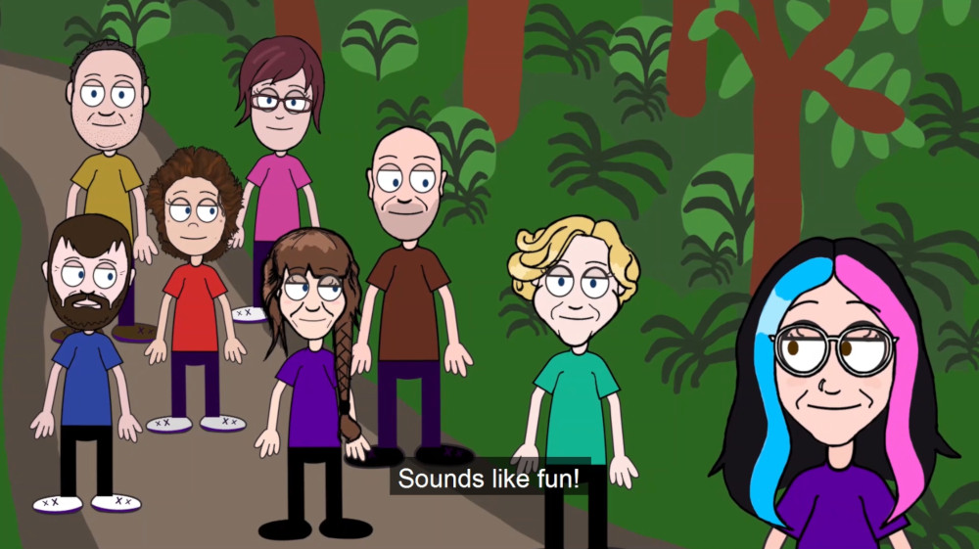
Film presentation: Including people with learning disabilities in research
Clip 2: The ambassadors talking to Rosie
This file has been removed from the presentation to reduce the file size, but you can view the whole film on YouTube here: https://youtu.be/mDeKUl1z7Bg

Slide 8
What are meaningful ways to involve people with learning disabilities and autism in research?
In bigger studies that involve wide populations, university-based researchers should think about how people with learning disabilities and autism can be engaged and recruited (see for example, Brooker et al., 2007).
University-based researchers should think about where they are sending information and make sure that this information is welcoming. It should be easy to read and easy to respond to (for example, see the work of Haas et al., 2017 and Lennox et al., 2005).
Participatory methods can give more space, time and freedom for high-quality knowledge to be generated.
People with learning disabilities and autism should have opportunities to lead research and not just be ‘participants’ (see for example, work by Chappell, 2000).
Relationships within the research are very important. A sense of belonging and opportunities to ‘add value’ are good for individuals and good for knowledge generation.

Slide 9
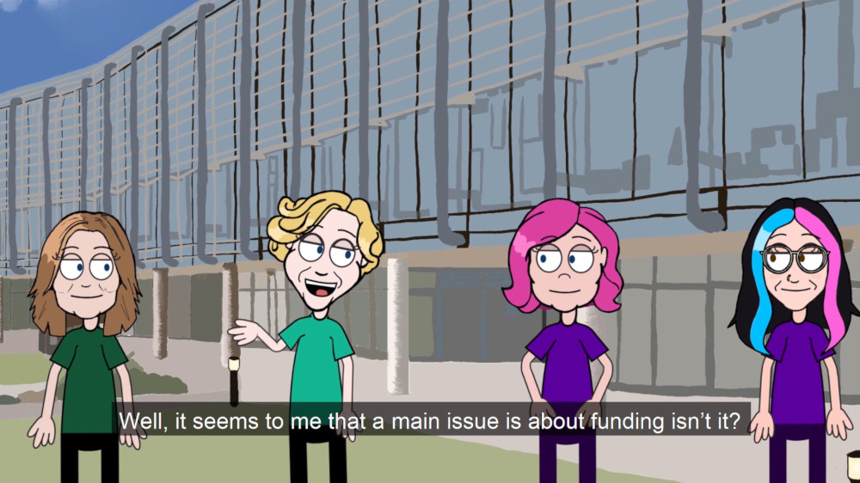
Film presentation: Including people with learning disabilities in research
Clip 3: Julia, Anne and Angie talking to Rosie
This file has been removed from the presentation to reduce the file size, but you can view the whole film on YouTube here: https://youtu.be/mDeKUl1z7Bg

Slide 10
What can research funders do to help inclusion of people with learning disabilities in research?
We need better information from research funders, so we can check that enough money is going to research with people with learning disabilities and autism. And so we can check that all research is properly inclusive (for example, see the Autistica Report on research funding Autistica-Scoping-Report.pdf).
The role of self-advocates in research is important (for example, see the work of Bigby, Frawley and Ramcharan, 2013; Goodley and Moore, 2000).
Research with people with learning disabilities and autism might need more time to do well. It might need more money to make materials accessible and longer timescales to do things properly.
Research funders need to see this. They need to make sure that there is enough funding available to do the research properly.
There should be better arrangements to keep going any activities that have been started from research projects. Research funders could work with other trust funders to develop exciting and creative ways to think about this differently.

Slide 11
What can we all do together to improve the inclusion of people with learning disabilities and autism in research?
We can make sure that there are opportunities for PhD students and other researchers to have training and peer learning so they can feel more confident and skilled in making research more inclusive.
We can have conversations between all of us to develop actions that can result in systems change improvements.
As the open letter from ‘Black Women Academics’ said, what is most urgent is the need for greater accountability of funding and research inclusion. See https://knowledgeispower.live/about/
University-based researchers and research funders need to be accountable for making sure that research is inclusive for people with learning disabilities and autism.
The SSHRC research council in Canada does Equalities Impact Assessment on their research funding decisions so that they can improve inclusion in research across communities. We would like to see this across UK research funders as well.

Slide 12
Reply from Eve Forrest
Economic and Social Research Council/UK Research and Innovation
Thank you Eve

Slide 13
Over to you!
What do you think about some of these questions and issues?
What do you think are the main points that research funders and researchers themselves need to hear and understand?

Slide 14
Next steps and final words
We would love to work with research funders, self-advocacy groups and organisations, community researchers and university-based researchers to make real progress.
Would you like to stay in touch and work with us?
Email: annerathbone@outlook.com
Thank you for joining us today.
Let’s keep talking and acting together!

Slide 15
Find out more!
Boingboing Resilience Research and Practice:
https://www.boingboing.org.uk/
Centre of Resilience for Social Justice at the University of Brighton:
https://www.brighton.ac.uk/crsj/index.aspx
Culture Shift – Arts Connect
https://www.cultureshift.org.uk/artsconnect
Sign up to our CRSJ/BB newsletter here!
https://www.boingboing.org.uk/about-us/subscribe-mailing-list/

